Slide 1
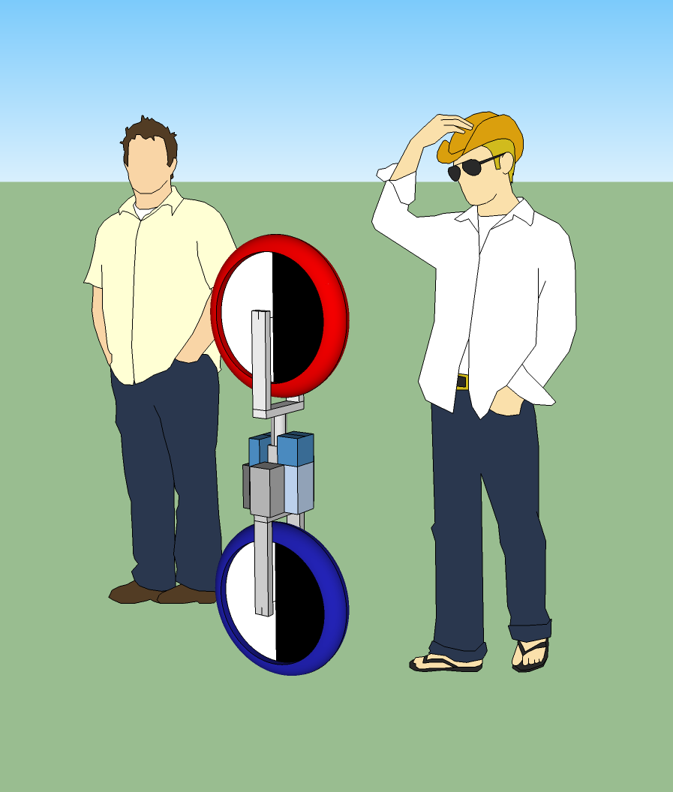
Project Overview
Use NI components to design and build a self balancing robotic unicycle
Notes:
We have been asked by national instruments to design and build a self balancing unicycle robot to showcase NI’s newest robotics toolkit. National Instruments has developed a full real time controlling suite to be all encompassing with the LabVIEW Robotics toolkit and their Real-Time controllers, specifically to us the compact Rio, or cRIO.

Slide 2
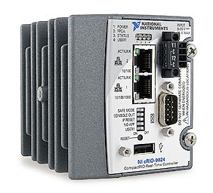
Project Plan
Robotics Environment Simulator
NIs cRIO real-time controller
State Space Control Design
Robot Construction
Debugging
Notes:
We will start by modeling the system in the labview robotics environment simulator, and develop our control algorithms using the simulator. Then, once we are confident in our control algorithms, we will use the cRIO to control our physical robot.

Slide 3
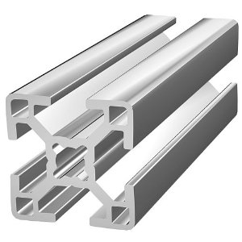
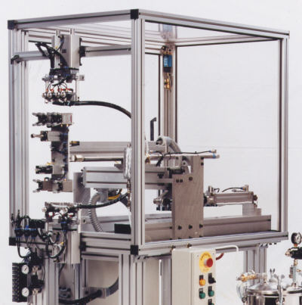
Building the Robot
Use of aluminum Extrusion
Ease to use
Versatile
Very adaptable to future changes
Brackets Necessary

Slide 4
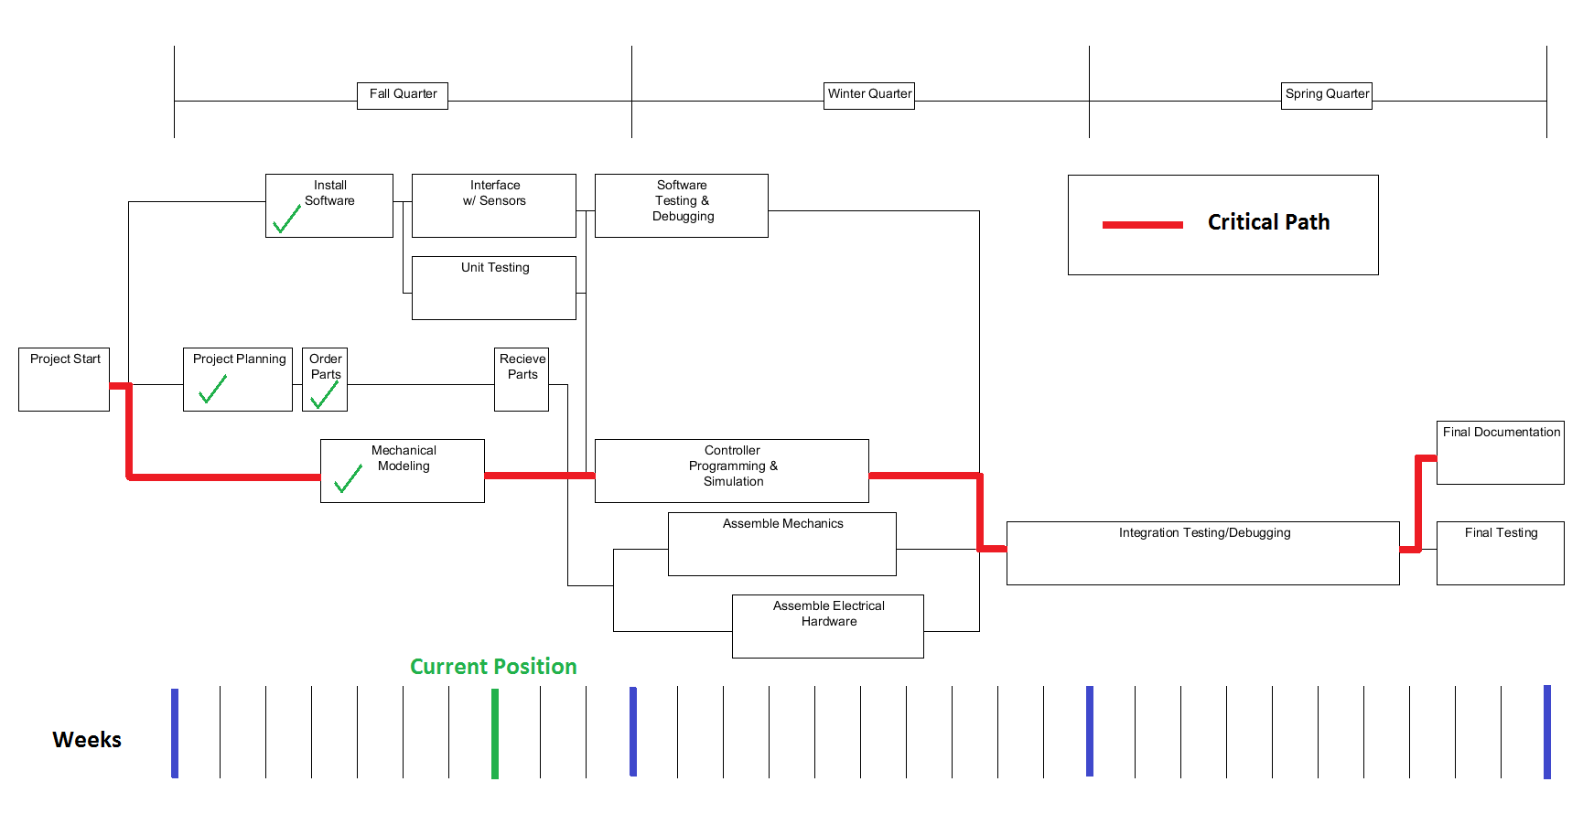
Project Diagram
Notes:
Here you can see our project plan. An important thing to note is how long we are leaving purely for debugging. We have a good understanding of the problem, and are confident that our solution will work, but one thing that we determined very early was that we would like to have a working version of it before the end of winter quarter to leave plenty of time to tune our control algorithm.

Slide 5
Parts List
LabVIEW Robotics | $15,000
Real Time Controller | $8,000
Controller Interface Module | $600
Wheel and Gyro Motors | $150
Motor Controller | $350
Wrist Motor | $150
Wrist Motor Controller | $400
Battery | $90
Inertial Measurement Unit | $3,000
Total | $27,740

Slide 6
Budget Breakdown

